Slide 1
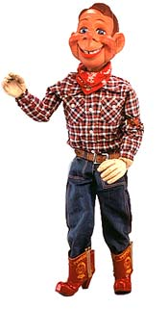
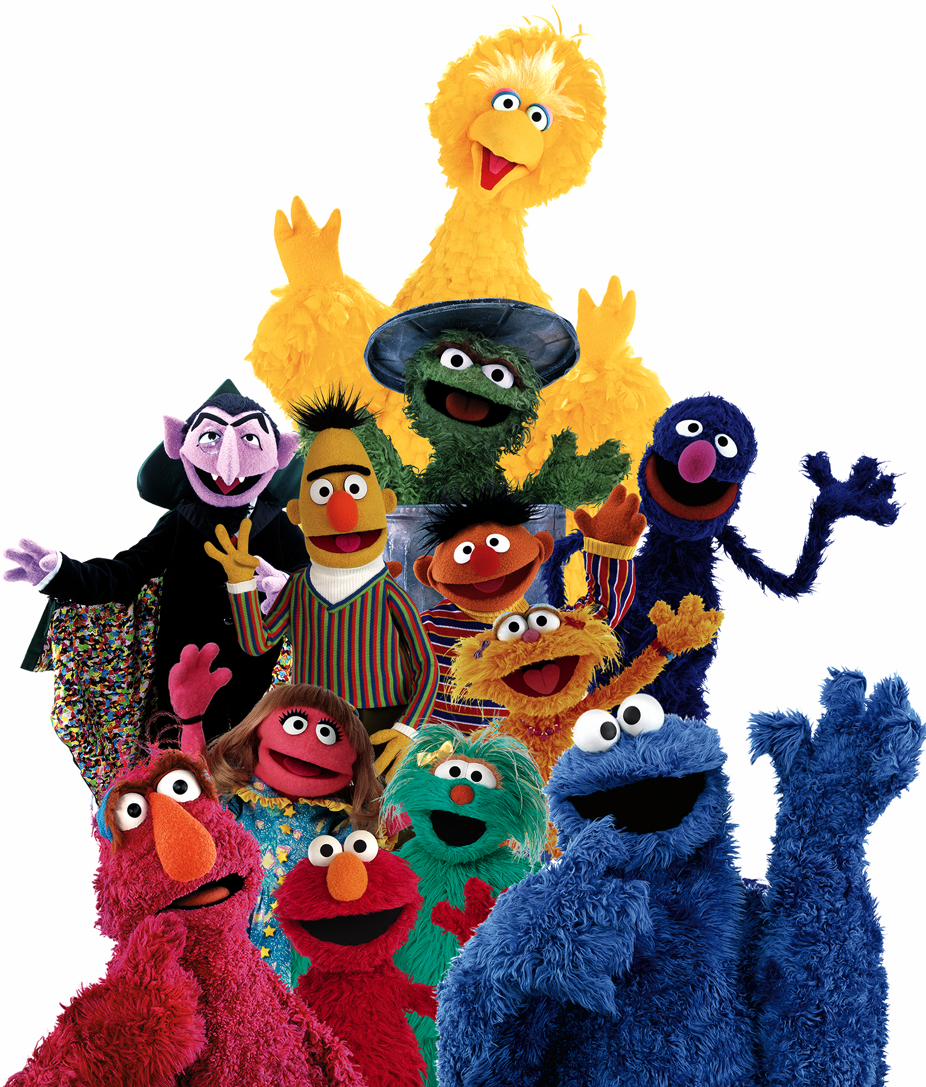
Children’s Television

Slide 2
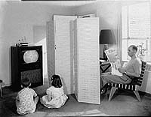
The Beginning
ABC aired the first Saturday Morning show for Children on August 19th, 1950
Animal Clinic which featured live animals and Acrobat Ranch which featured two young acrobats, Tumbling Tim and Flying Flo, and had a circus theme.
The programming was only two hours long

Slide 3
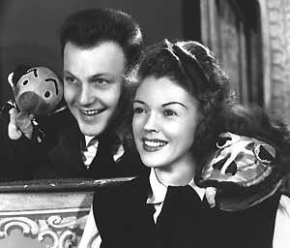
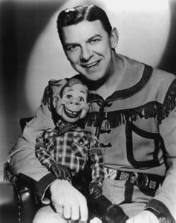
A New Audience
By 1951 networks would include up to 27 hours of television programming dedicated to children
Howdy Doody and Kukhla, Fran and Ollie are examples

Slide 4
Animated Weekends
Began with Crusader Rabbit on NBC which ran from 1950-1952
In 1955 CBS began airing “The Mighty Mouse Playhouse”
The 1960’s began the era of Saturday Morning Cartoons

Slide 5
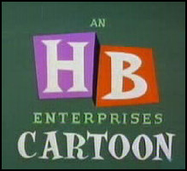
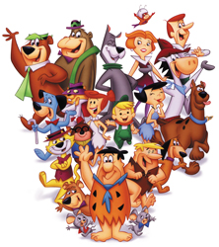
Hanna-Barbera
Founded by former MGM animation directors William Hanna, Joseph Barbera and George Sidney
Produced cheaply made cartoons such as The Flintstones, The Rocky and Bullwinkle Show, and the Yogi Bear Show among others.

Slide 6
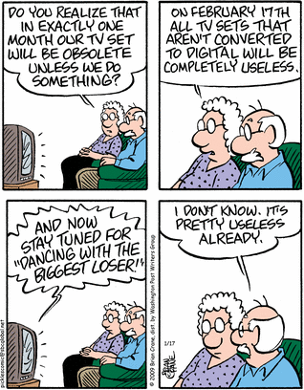
The “Vast Wasteland”
On May 9th, 1961 FCC chairman Newton N. Minow gave a speech titled “Television and the Public Interest”
"When television is good, nothing — not the theater, not the magazines or newspapers — nothing is better.
But when television is bad, nothing is worse”

Slide 7
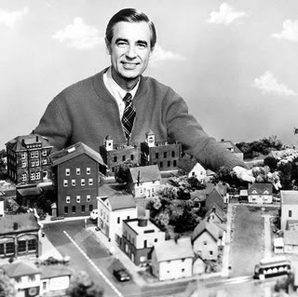
Educational Programming
Eventually Educational Programming geared towards children was made
Sesame Street- meant to help young children prepare for school, especially those from low-income families.
Mister Rogers Neighborhood- talked about issues other shows would not

Slide 8
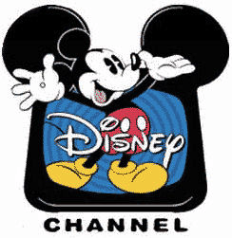
Cable Television
Networks like Nickelodeon and Cartoon Network emerged
This contributed to a decline in interest for Saturday Morning Cartoons
Now networks had to compete with channels that operated under different guidelines

Slide 9
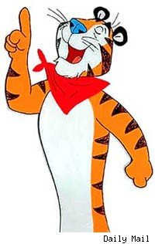
The Advertising Epiphany
children are exposed to TV between 6-12 mos. of age
1951 - - 30% of children under the age of 16 watch television
between the ages of 2 & 3 kids watch on average 3 hours of TV
watching occurs primarily after school, in the evening and on weekends

Slide 10
The Advertising Epiphany
shows like Howdy Doody aired at 5 PM to target children audiences
primary purpose was and is to influence attitude and resulting behaviors of viewers
Howdy Doody Intro & Advertisement: 1947-1960

Slide 11
The Advertising Epiphany
children have a hard time discerning what is actual programming and commercial
a study of 5-7 year olds showed that between 55-64% of the time kids new the difference between a show and ad
teens, “tweens” and children help control parental dollars

Slide 12
The Advertising Epiphany
children have become much more materialistic
a study done in 1975 says that more than half of kids denied an item threw a fit
those under the age of 18 help parents spend upwards of $670 billion yearly

Slide 13
Let’s Narrowcast!
CATV (community antenna television) was the first conceptual cable system - 1948
by the 1960’s cable companies start to spring up
in 1972 the FCC lifted its restrictions on cable operators to provide movies, syndicated programming & sporting events
Narrowcast
cable becomes a way to fulfill the obligation of providing for the public interest

Slide 14
Let’s Narrowcast!
1977 Pinwheel went on the air through Warner Cable in Columbus, OH
Pinwheel’s primary program was the actual show Pinwheel which incorporated live characters and cartoons
after seeping into the Buffalo, NY market, Pinwheel becomes Nickelodeon in 1979

Slide 15
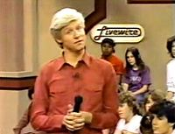
1979-1984
from its birth Nickelodeon had both syndicated and original programming
early programming encouraged educational TV like “Livewire” a kids talk-show where kids talk about current events
Livewire Commercial - 1980-1985

Slide 16
1984 –
The Turning Point
by 1984 the network had lost almost $40 million
overhaul at the corporate level led to a semi-new format
new logo and programming led the #1 spot amongst children programming

Slide 17
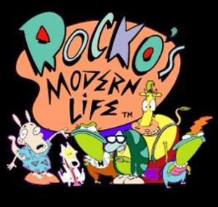
The 90’s
by 1990 Nick was seen in 52 million homes
new shows like Rugrats, Rocko’s Modern Life & Doug came in the early 90’s
original programming became the headline of the network

Slide 18
A.C.T
Action for Children’s Television
ACT was founded in 1968 in Massachusetts as a response to programming on WHDH-TV
the group focused primarily on commercial abuses of children
members fought for “public interest” television with emphasis on education for kids
1992 – ACT disbands

Slide 19
The Future
Television will continue to evolve.
Multiple screens and social media will become more involved.
Educational programming will be important, but may be marginalized.

