Slide 1
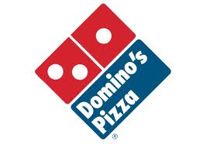
Domino’s Digital
Marketing Campaign

Slide 2
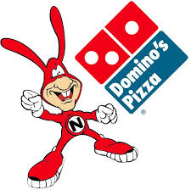
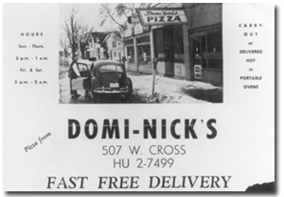
Background
Founded in 1960 in Ypsilanti, Michigan,
now has headquarters in Ann Arbor, Michigan.
Operates 10,566 stores in more than 70
countries
Busiest day is Superbowl Sunday, following by
Halloween, New Years Eve, New Years Day, and
Thanksgiving Eve.
Domino’s customers are primarily southern white middle class home owners who have lived in their house for over five years. Both men and women order the pizza, however slightly more women (51.6%) purchase than men (48.4%). They are married between the ages of 18 and 54. Income is about $75,000-$149,999. Education is primarily high school and no college.
40% of sales come from digital channels.

Slide 3
SWOT ANALYSIS
Strengths
Opportunities
Threats
Weaknesses
Domino’s lacks optimized app for iPad, of which 29.4% of those ages 18-34 in the U.S. own.
Store employees answer phone orders, as well as make pizzas, decreasing efficiency, especially in peak demand hours.
Over 80% of the U.S. population is aware of Domino’s Pizza
The Domino’s app is available for 95% of smart phones. The other 5% consists of those who have Blackberry phones and a company called Symbian, which is an open source operating system that has dropped in popularity after the release of the Android.
Domino’s operates in an over saturated pizza delivery market.
Take advantage of consumers having smart phones to help increase Domino’s app usage.
Pizza Hut already has an app for iPads and Papa Johns has a rewards system when ordering online for their consumers.
Fresher ingredients and a revamped menu give Domino’s an advantage for more health conscious consumers and those who may be on a budget.

Slide 4
The Goal
To increase the number of consumers that uses the Domino’s app by 10%.
To engage consumers aged 18-34 to use the mobile app not just at home, but when they are out as well.

Slide 5
Competition
Papa John’s
Pizza Hut
Opened in 1987
Now has 4,200 restaurants in 50 states and 30 countries.
Has online ordering that implements a reward system.
Unlike competitors, Papa John’s skews towards higher income consumers.
Digital ordering accounts for 25% of sales
Opened in 1958 in Wichita, Kansas
Has over 11,000 stores in the US and 96 countries
18-34s, black consumers, those living in the Southwest, and those with 3+ kids are more likely to visit Pizza Hut for “any” use.
Mobile app for Android, iPhone, and iPad.
Digital ordering accounts for 30% of sales
Notes:
Papa Johns: http://ir.papajohns.com/releasedetail.cfm?releaseid=465852
Pizza Hut: http://www.pizzahutfranchise.com/about-best-pizza-franchise.php
http://www.mobilecommercedaily.com/pizza-hut-overhauls-mobile-ordering-to-support-skyrocketing-volume

Slide 6
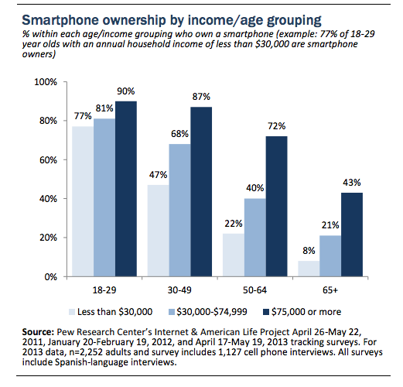
TARGET AUDIENCE FOR DIGITAL CHAMPAIGN
The Mobirati (make up 20% of the market) and Social Connectors (make up 22% of the market). 18-34 year olds who are already familiar with mobile devices and social media and therefore are most likely to use the app and online ordering as orders increase by 18% when made over the phone.
Notes:
http://pizzasalesonline.com/online-pizza-ordering/online-pizza-order-is-18-higher-than-by-phone/
http://boletines.prisadigital.com/PIP_Smartphone_adoption_2013.pdf

Slide 7
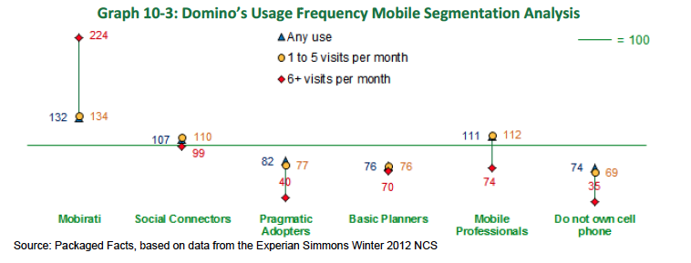
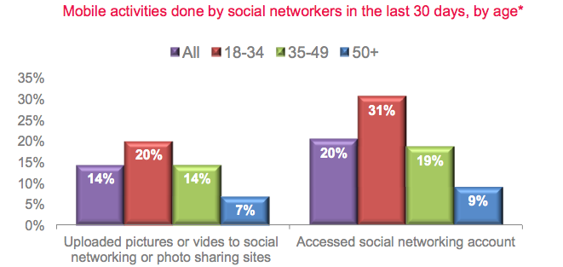
Notes:
http://www.experian.com/assets/simmons-research/white-papers/experian-simmons-2011-mobile-consumer-report.pdf

Slide 8
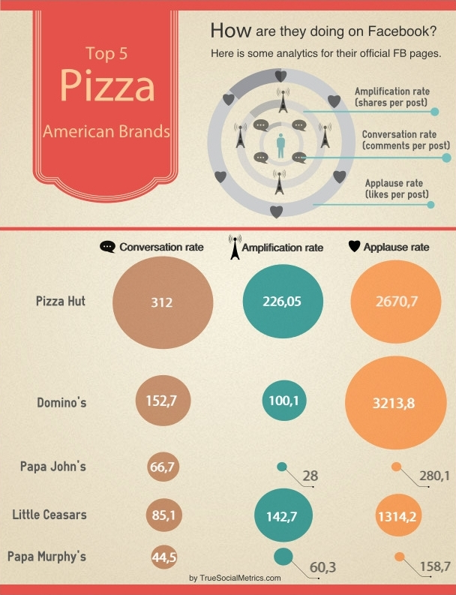
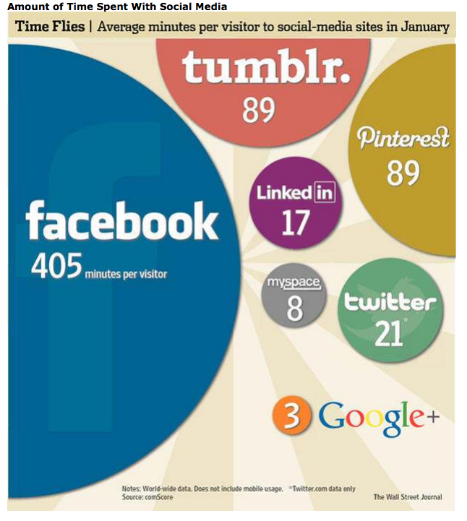
Social Media and Competition

Slide 9
Current Domino’s Social Media
Instagram
4,342 followers
Youtube
3,148 subscribers · 2,195,286 views since Nov 5, 2007
Twitter
410,961 followers
Facebook
8,820,294 likes · 30,118 talking about this · 4,013 were here
Facebook stats taken from Socialbaker.com

Slide 10
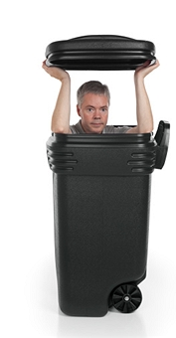
Our Campaign
To engage customers by creating a challenge: Dare Domino’s to find you!

Slide 11
Strategy
Campaign will run all year, beginning in October and ending in September.
TV ads run in the first few months to spark the idea of those with smart phones but may not use a wide variety of apps
Post online videos throughout the year releasing one at a time every few weeks allowing for people to share on social sites
Display in store displays all year
Have more on-line advertising before big holidays such as Christmas, New Years, 4th of July, Labor Day, Mother’s/Father’s Day and so on.
Contest will only run from October to December to highlight the key holidays.
Notes:
http://www.compuware.com/content/dam/compuware/apm/assets/case-studies/CS_Dominos.pdf

Slide 12
The Concept
When ordering through the app, customers can use the special instructions which allows you to have Domino’s delivered to all sorts of places.
Challenge consumers to use the application to deliver to unusual areas, thus “Daring Domino’s” to find them.
Picnics
Camping
Waiting in line for Black Friday Deals
The goal is to draw attention to the convenience of the application, while making it a game for the customer to find weird places and situations to get pizza delivered to.

Slide 13
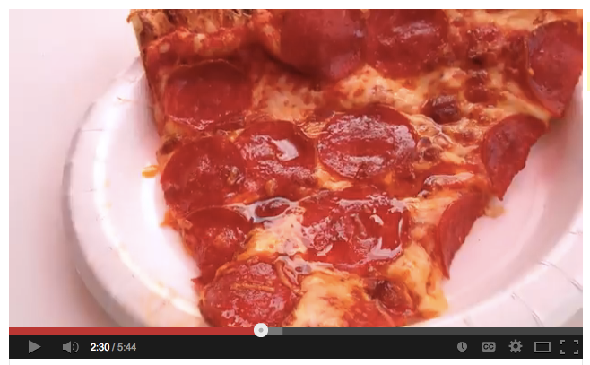
Creative
Hashtag
The hashtag #DareDominos creates the ability to share experiences while ordering and giving an element of a challenge.
Videos
Will be online and easily sharable on Facebook, Twitter, and other social media sites.
13

Slide 14
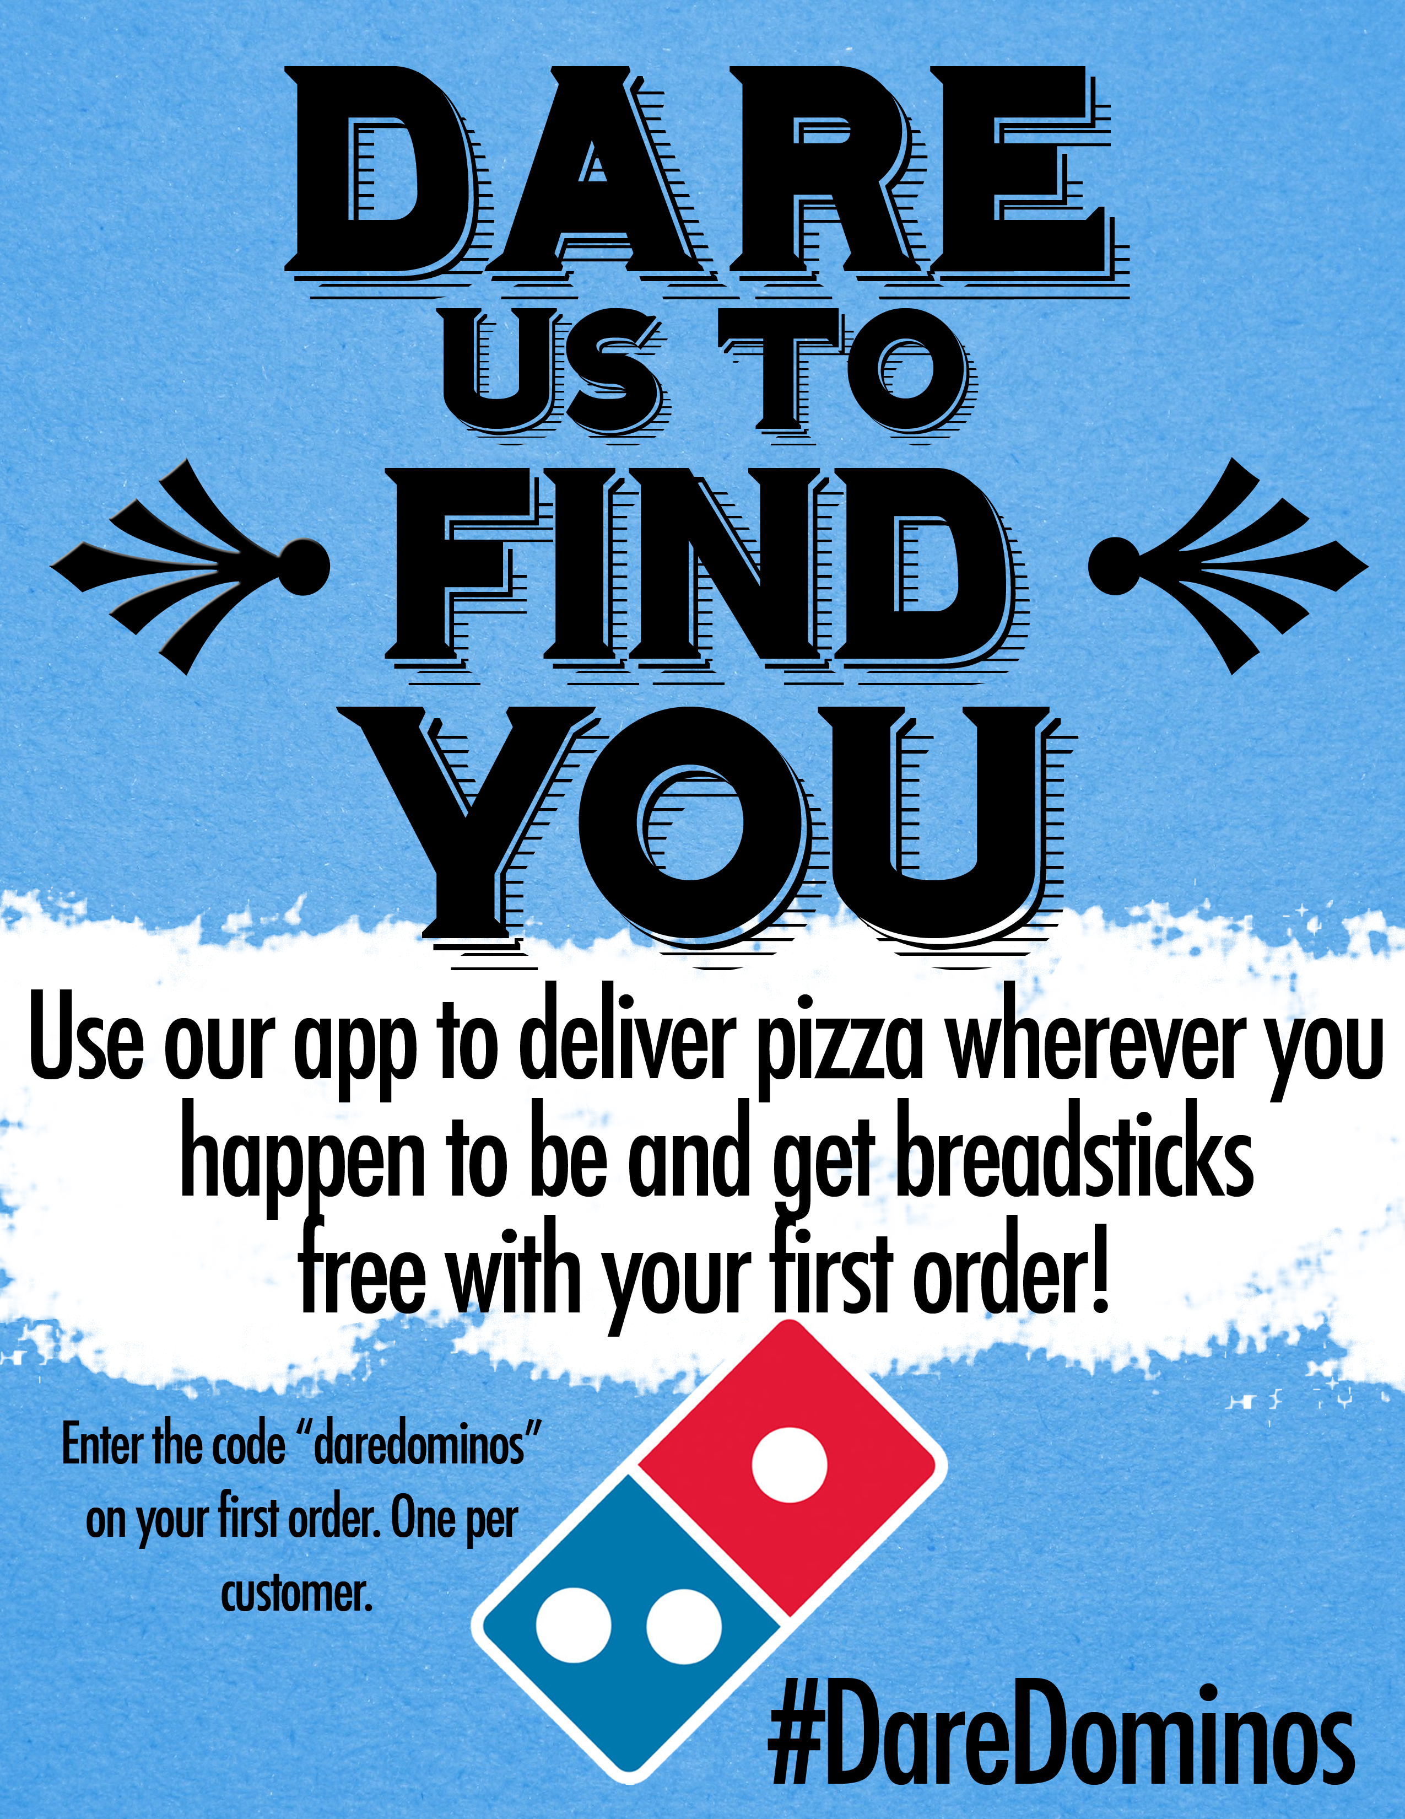
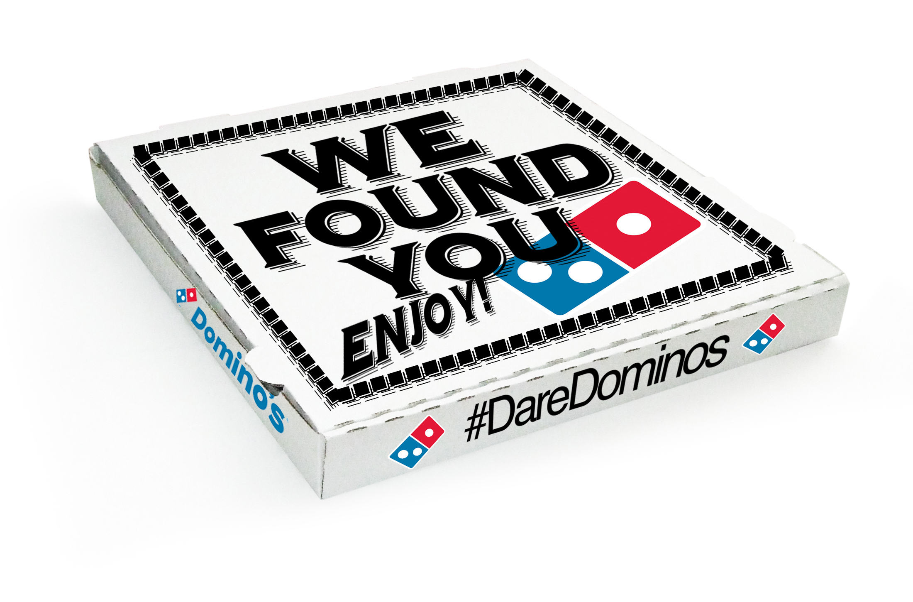
Hard Copy
InStore
Displays in store will dare customers to order with their app, even to unusual locations. First time users will be able to get a free order of breadsticks as a reward for trying the app
Pizza Box
A message of “We Found You” on the box will create a game like feel and the hashtag will remind customers to share their experience
14

Slide 15
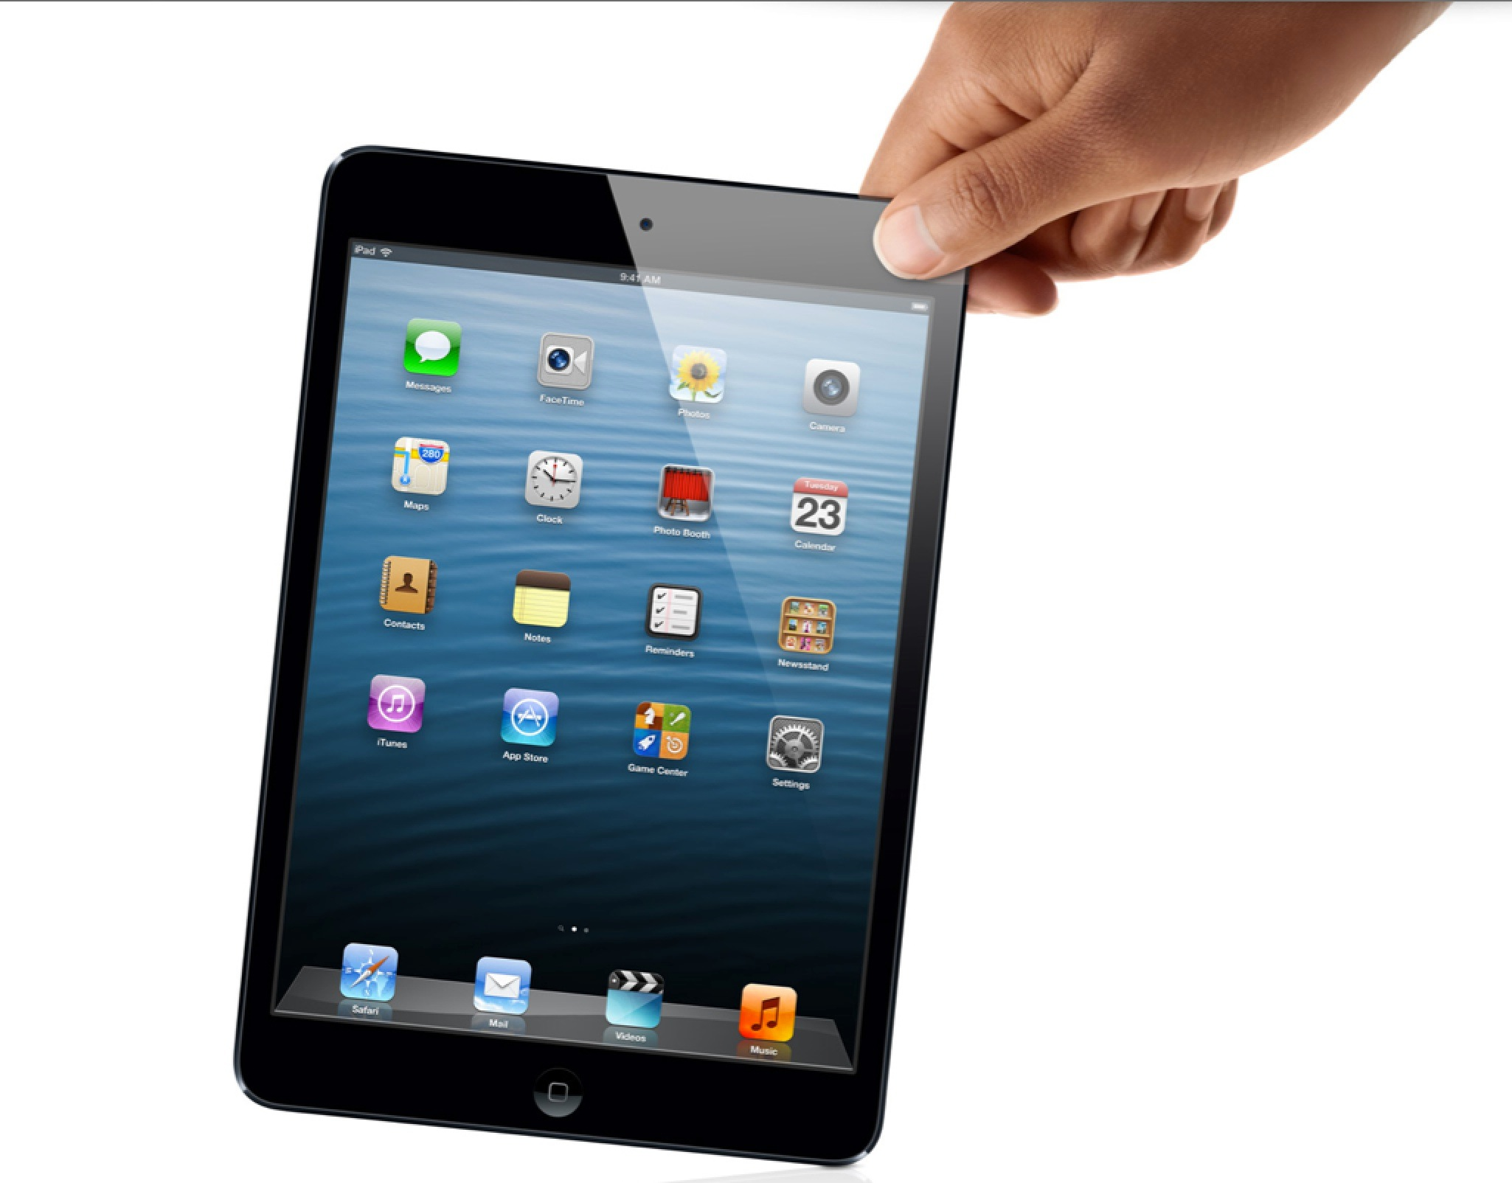
Contest
As an incentive for people to use the app, there will be a contest to win an iPad
To enter the contest, participants will just have to take a picture of themselves using the app in the place they “dared” Domino’s to find them and upload this picture to Facebook, Twitter, or Instagram with the hashtag #DareDominos.
Create an optimized iPad app
15

Slide 16
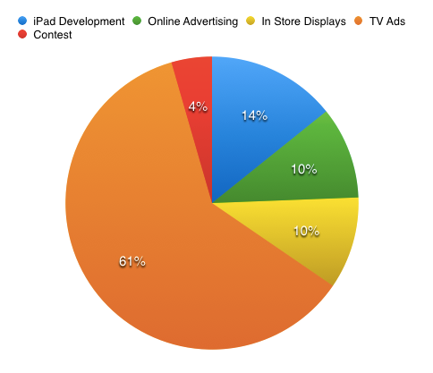
Budget
16

Slide 17
Expected Results
Sales will increase as there is an increase in the use of the application (expected ROI is around 18%).
Year round sales will see an increase as well.
The brand will continue to carry on its mission of delivering quality pizza by allowing consumers to have better access to ordering.

